Slide 1
Mechnical Engineering
.
https://youtu.be/H5L1Rjmgeig engineer
…
https://youtu.be/7YegXe_S1ys satisfaction
https://youtu.be/dwyQaQI4XMY Phineas and Ferb
Christopher Bauman – www.chrisbauman.com.au

Slide 2
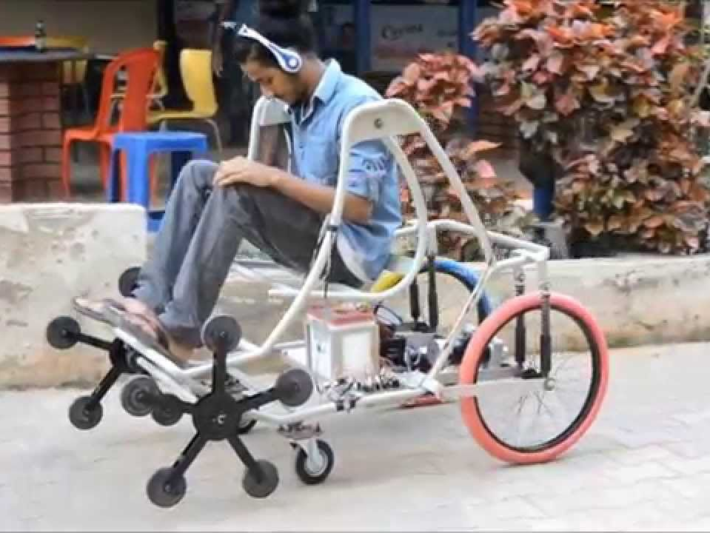
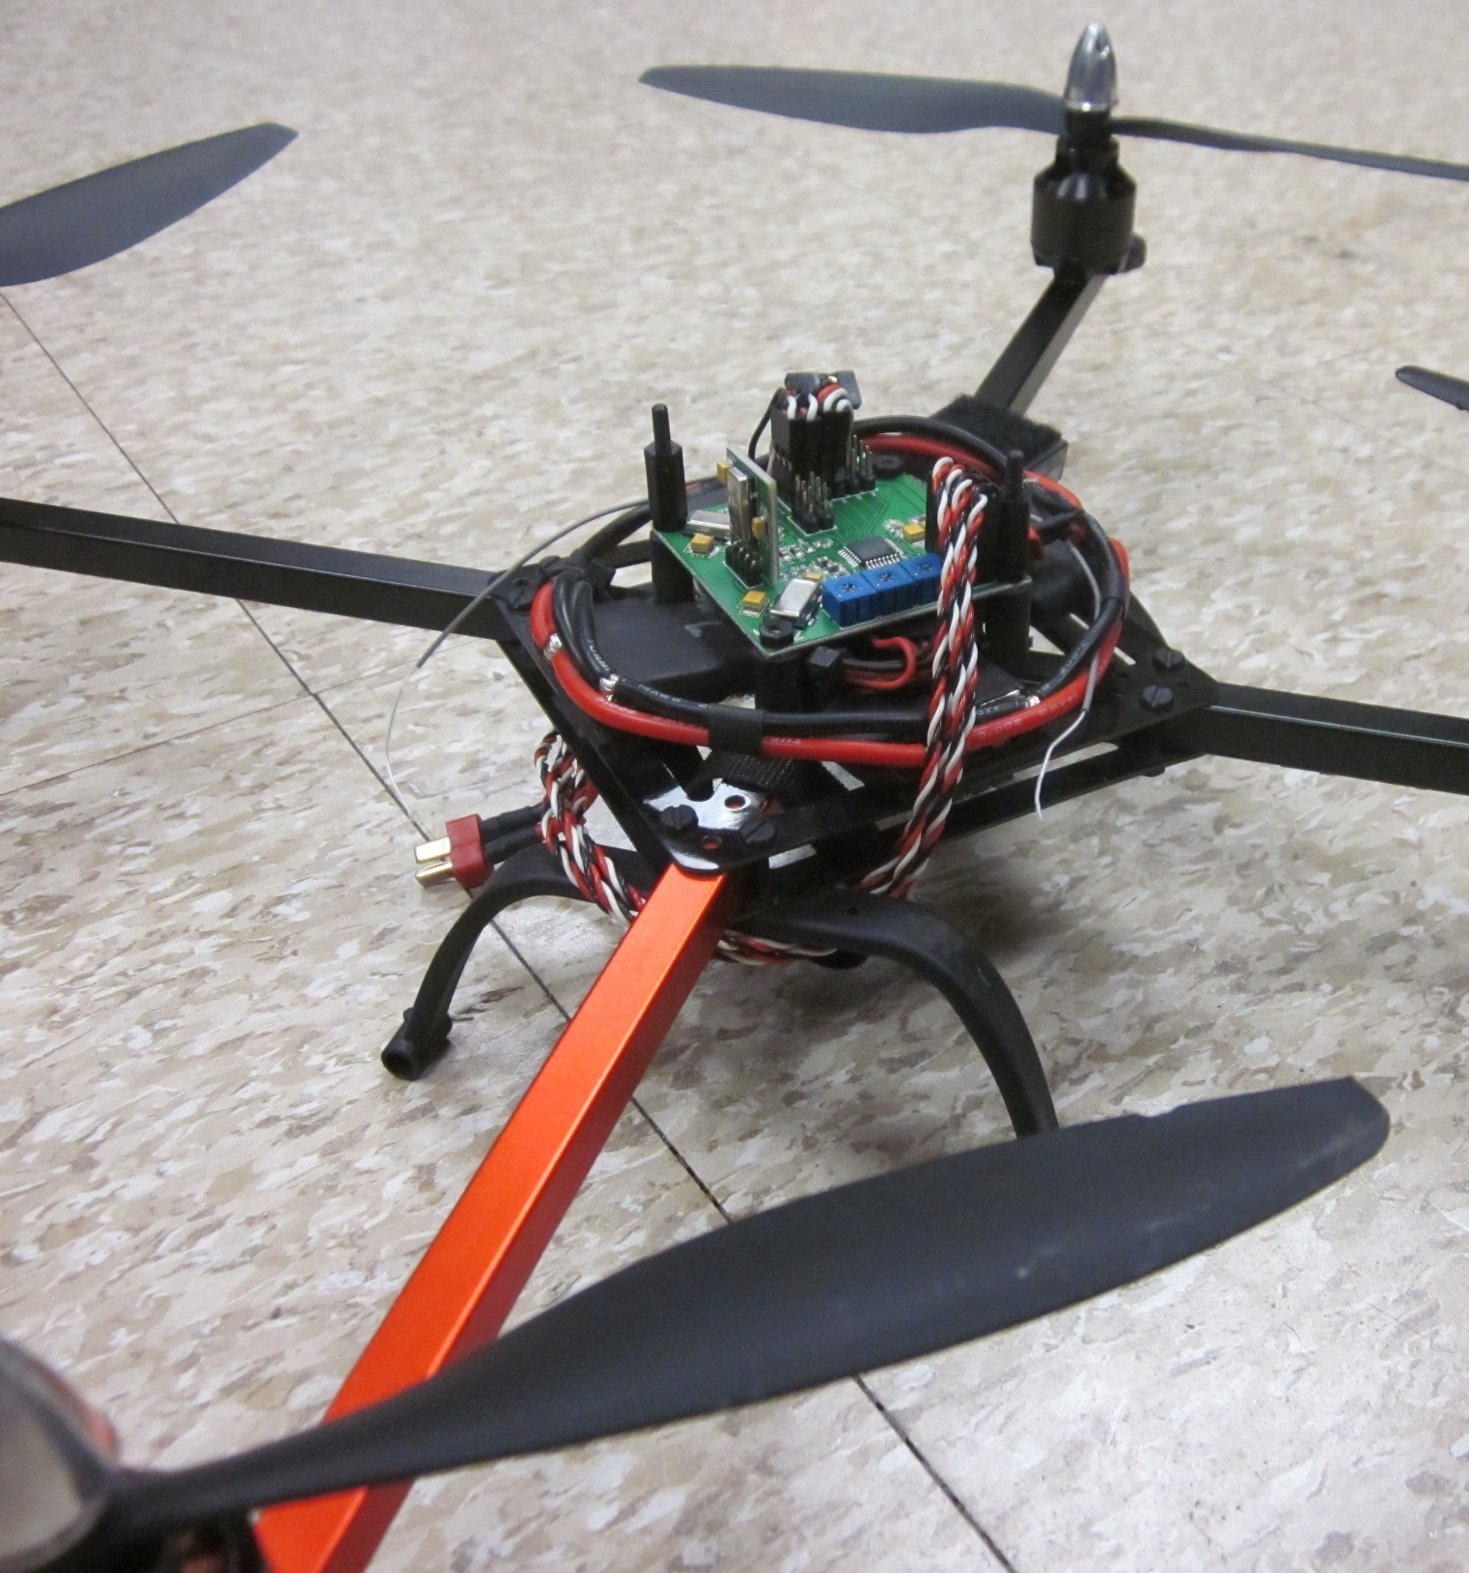
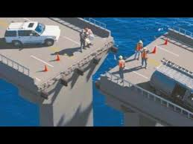

Slide 3
